Slide 1
Repeated-measures designs (GLM 4)
Prof. Andy Field

Slide 2
Aims
Rationale of Repeated Measures ANOVA
One- and two-way
Benefits
Partitioning Variance
Statistical Problems with Repeated Measures Designs
Sphericity
Overcoming these problems
Interpretation

Slide 3
Benefits of Repeated Measures Designs
Sensitivity
Unsystematic variance is reduced.
More sensitive to experimental effects.
Economy
Less participants are needed.
But, be careful of fatigue.

Slide 4
An Example
Are certain Bushtucker foods more revolting than others?
Four Foods tasted by 8 celebrities:
Stick Insect
Kangaroo Testicle
Fish Eyeball
Witchetty Grub
Outcome:
Time to retch (seconds).

Slide 5
The Data

Slide 6
Theory of one-way repeated-measures ANOVA

Slide 7
Problems with Analyzing Repeated Measures Designs
Same participants in all conditions.
Scores across conditions correlate.
Violates assumption of independence.
Assumption of Sphericity.
Crudely put: the correlation across conditions should be the same.
Adjust Degrees of Freedom.

Slide 8
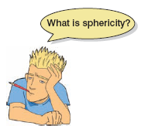
The Assumption of Sphericity
Basically means that the correlation between treatment levels is the same.
Actually, it assumes that variances in the differences between conditions is equal.
Measured using Mauchly’s test.
P < .05, Sphericity is Violated.
P > .05, Sphericity is met.
Notes:
variances.

Slide 9
What is Sphericity?

Slide 10
Estimates of Sphericity
Three measures:
Greenhouse-Geisser Estimate
Huynh-Feldt Estimate
Lower-bound Estimate
Multiply df by these estimates to correct for the effect of Sphericity.
G-G is conservative, and H-F liberal.

Slide 11
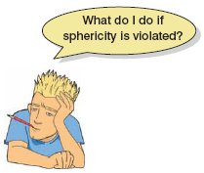
Correcting for Sphericity
df = 3, 21
0.533 = 1.59
0.533 = 11.19
3
21
x
x
0.666 = 13.98
0.666 = 1.99
0.333 = 1.00
0.333 = 7.00

Slide 12
Output

Slide 13
Interpretation: Main Effect

Slide 14
Post Hoc Tests
Compare each mean against all others (t-tests).
In general terms they use a stricter criterion to accept an effect as significant.
Hence, control the familywise error rate.
Simplest example is the Bonferroni method:

Slide 15
What is Two-Way Repeated Measures ANOVA?
Two Independent Variables
Two-way = 2 IVs
Three-Way = 3 IVs
The same participants in all conditions.
Repeated Measures = ‘same participants’
A.k.a. ‘within-subjects’

Slide 16
An Example
Field (2013): Effects of advertising on evaluations of different drink types.
IV 1 (Drink): Beer, Wine, Water
IV 2 (Imagery): Positive, negative, neutral
Dependent Variable (DV): Evaluation of product from -100 dislike very much to +100 like very much)

Slide 17
SS_{T}
Variance between all participants
SS_{M}
Within-Particpant Variance Variance explained by the experimental manipulations
SS_{R}
Between-Participant Variance
SS_{A}
Effect of Drink
SS_{B}
Effect of Imagery
SS_{A × B}
Effect of Interaction
SS_{RA}
Error for Drink
SS_{RB}
Error for Imagery
SS_{RA × B}
Error for Interaction

Slide 18
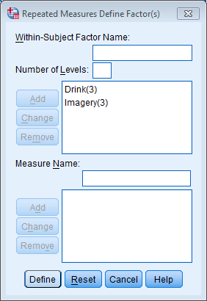
Running the Analysis: Naming factors

Slide 19
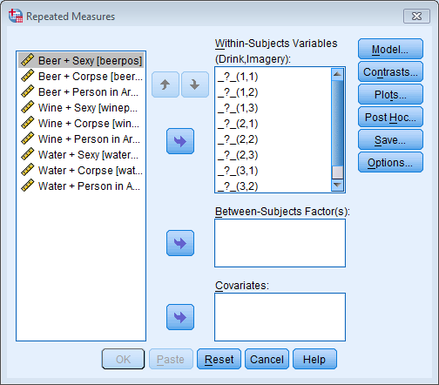
Defining Variables

Slide 20
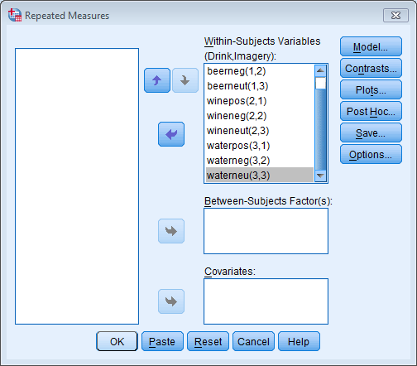
Defining Variables

Slide 21
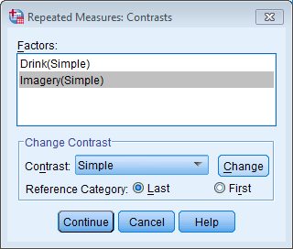
Contrasts

Slide 22
Plots

Slide 23
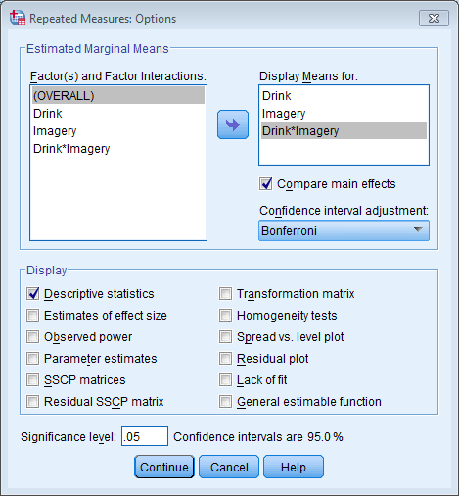
Getting Means

Slide 24
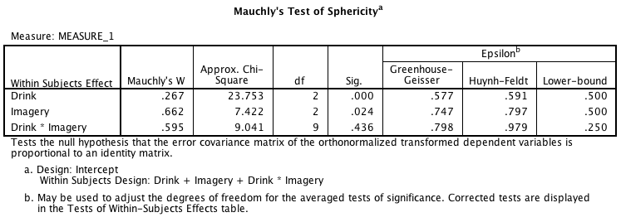
Output: Sphericity

Slide 25
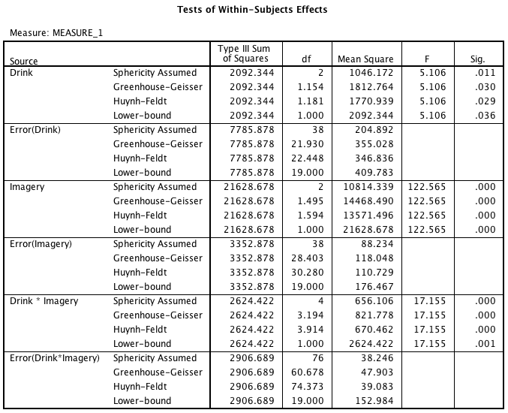
Output: Main ANOVA

Slide 26
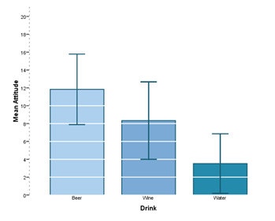
Main Effect of Drink
F(1.15, 21.93) = 5.11, p = .01

Slide 27
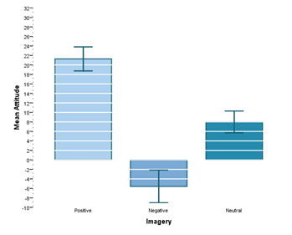
Main Effect of Imagery
F(1.50, 28.40) = 122.57, p < .001

Slide 28
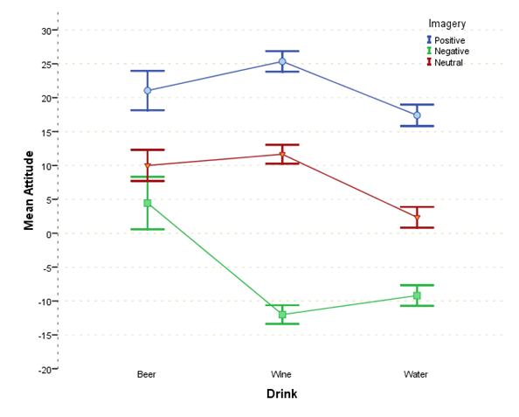
Drink by Dose Interaction
F(4, 76) = 17.16, p < .001

Slide 29
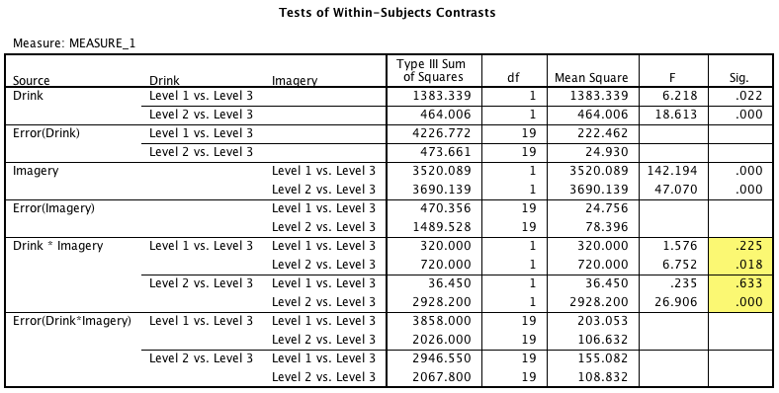
Contrasts

